Slide 1
HTML 5 attributes

Slide 2
Agenda
HTML 5 attributes
Sample output
HTML 5 attributes implementation

Slide 3
HTML 5 attributes
The HTML 5 has additional features when compared to Html.
Some HTML 5 attributes to mention is number, email, min, max, search and many more features.
HTML 5 makes the programming easy and better.

Slide 4
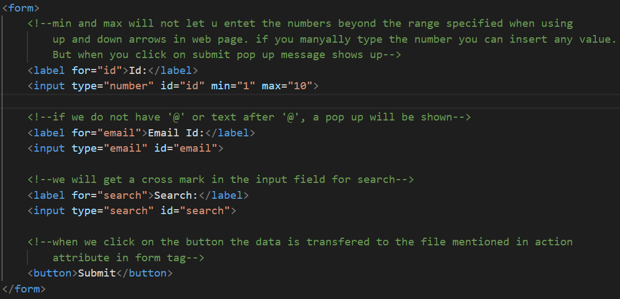
Sample Output

Slide 5
HTML 5 attributes implementation
Let’s see some attributes implementation.

Slide 6
Summary
We have seen some HTML 5 attributes implementation.
DO NOT WRITE ANYTHING
HERE. LEAVE THIS SPACE FOR
WEBCAM

Slide 7
Thank You
Proprietary content. ©Great Learning. All Rights Reserved. Unauthorized use or distribution prohibited

